Slide 1

Sequence to sequence models
Basic models
deeplearning.ai

Slide 2

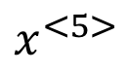
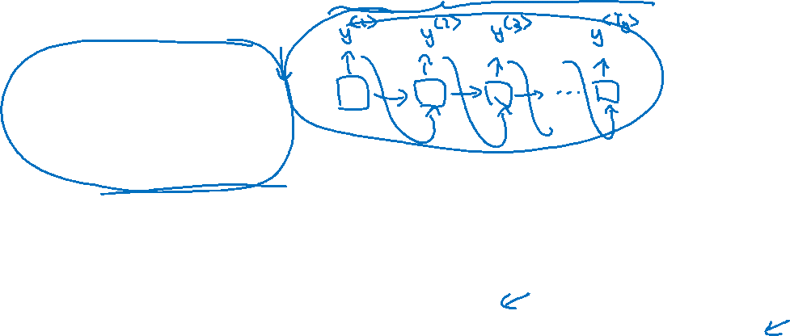
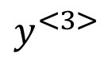
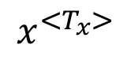
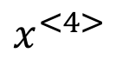
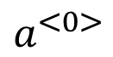
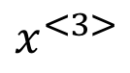
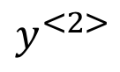
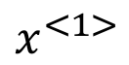
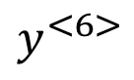
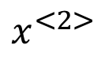
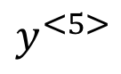
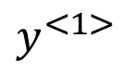
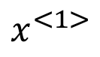
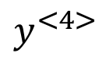
Sequence to sequence model
$$x^{<1>}$$
$$x^{<2>}$$
$$x^{<3>}$$
$$x^{<4>}$$
$$x^{<5>}$$
Jane visite l’Afrique en septembre
Jane is visiting Africa in September.
$$y^{<1>}$$
$$y^{<2>}$$
$$y^{<3>}$$
$$y^{<4>}$$
$$y^{<5>}$$
$$y^{<6>}$$
$$a^{<0>}$$
$$⋯$$
$$x^{<1>}$$
$$x^{<T_{x}>}$$
[Sutskever et al., 2014. Sequence to sequence learning with neural networks]
[Cho et al., 2014. Learning phrase representations using RNN encoder-decoder for statistical machine translation]

Slide 3
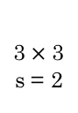
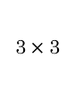
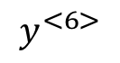
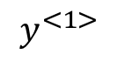
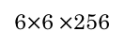
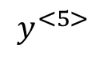
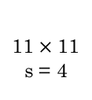
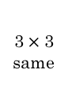
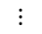
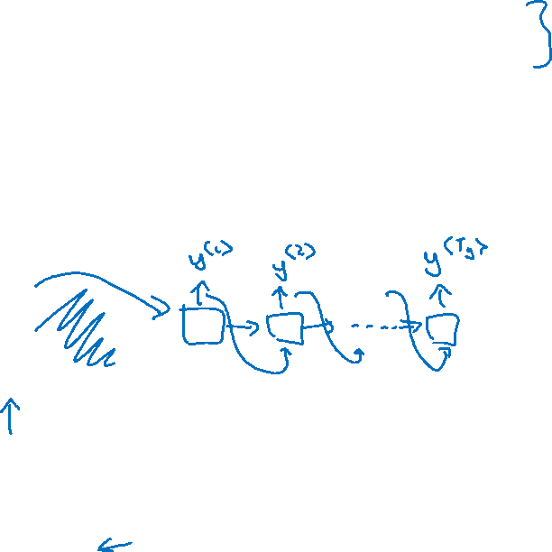
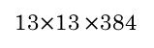
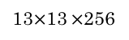
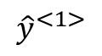
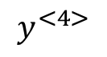
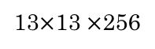
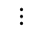
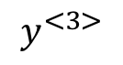
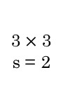
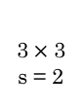
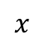
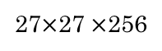
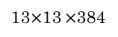

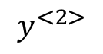
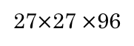
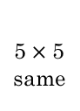
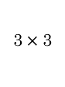
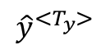
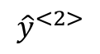
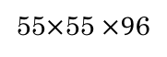
Image captioning
$$y^{<1>}$$
$$y^{<2>}$$
$$y^{<3>}$$
$$y^{<4>}$$
$$y^{<5>}$$
$$y^{<6>}$$
A cat sitting on a chair
MAX-POOL
MAX-POOL
11$×$ 11
s = 4
3$×$ 3
s = 2
5$×$ 5
same
3$×$ 3
s = 2
3$×$ 3
same
3$×$ 3
55$×$55 $×9$6
27$×$27 $×$96
27$×$27 $×$256
13$×$13 $×$256
13$×$13 $×$384
MAX-POOL
=
3$×$ 3
3$×$ 3
s = 2
$$⋮$$
$$⋮$$
$$⋮$$
Softmax
1000
13$×$13 $×$384
13$×$13 $×$256
6$×$6 $×$256
9216
4096
4096
$${\hat{y}}^{<1>}$$
$${\hat{y}}^{<2>}$$
$${\hat{y}}^{<T_{y}>}$$
$$⋯$$
$$x$$
[Mao et. al., 2014. Deep captioning with multimodal recurrent neural networks]
[Vinyals et. al., 2014. Show and tell: Neural image caption generator]
[Karpathy and Li, 2015. Deep visual-semantic alignments for generating image descriptions]

Slide 4
Sequence to sequence models
Picking the most likely sentence
deeplearning.ai

Slide 5
Machine translation as building a conditional language model
$${\hat{y}}^{<1>}$$
$${\hat{y}}^{<2>}$$
$${\hat{y}}^{<T_{y}>}$$
Language model:
$$a^{<0>}$$
$$⋯$$
$$x^{<1>}$$
$$x^{<2>}$$
$${{\hat{y}}^{<1>}}^{ }$$
$${{\hat{y}}^{<T_{y}>}}^{ }$$
Machine translation:
$$a^{<0>}$$
$$⋯$$
$$⋯$$
$$x^{<1>}$$
$$x^{<T_{x}>}$$

Slide 6
Finding the most likely translation
Jane visite l’Afrique en septembre.
$$P(y^{<1>},…,y^{<T_{y}>}| x)$$
Jane is visiting Africa in September.
Jane is going to be visiting Africa in September.
In September, Jane will visit Africa.
Her African friend welcomed Jane in September.
$${ \underset{y^{<1>}{,…,y}^{<T_{y}>}}{arg max}{P(y^{<1>},…,y^{<T_{y}>}| x) }}_{ }^{ }{ }$$

Slide 7
Why not a greedy search?
$${{\hat{y}}^{<1>}}^{ }$$
$${{\hat{y}}^{<T_{y}>}}^{ }$$
$$a^{<0>}$$
$$⋯$$
$$⋯$$
$$x^{<1>}$$
$$x^{<T_{x}>}$$
Jane is visiting Africa in September.
Jane is going to be visiting Africa in September.

Slide 8
Sequence to sequence models
Beam search
deeplearning.ai

Slide 9
Beam search algorithm
Step 1
a
$$P(y^{<1>} | x)$$
$$⋮$$
in
$${{\hat{y}}^{<1>}}^{ }$$
$$⋮$$
$$a^{<0>}$$
$$⋯$$
$$10000$$
jane
$$⋮$$
$$x^{<1>}$$
$$x^{<T_{x}>}$$
september
$$⋮$$
zulu

Slide 10
Beam search algorithm
Step 1
Step 2
$$a^{<0>}$$
$$⋯$$
a
$$⋮$$
$$x^{<1>}$$
$$x^{<T_{x}>}$$
in
$$⋮$$
$$10000$$
jane
$$a^{<0>}$$
$$⋯$$
$$⋮$$
september
$$x^{<1>}$$
$$x^{<T_{x}>}$$
$$⋮$$
zulu
$$a^{<0>}$$
$$⋯$$
$$x^{<1>}$$
$$x^{<T_{x}>}$$

Slide 11
Beam search $(B=3)$
in
september
$${{\hat{y}}^{<3>}}^{ }$$
in september
$$a^{<0>}$$
$$⋯$$
$$x^{<1>}$$
$$x^{<T_{x}>}$$
jane
is
$${{\hat{y}}^{<3>}}^{ }$$
jane is
$$a^{<0>}$$
$$⋯$$
$$x^{<1>}$$
$$x^{<T_{x}>}$$
jane
visits
$${{\hat{y}}^{<3>}}^{ }$$
jane visits
$$a^{<0>}$$
$$⋯$$
$$x^{<1>}$$
$$x^{<T_{x}>}$$
$$P(y^{<1>},y^{<2>}| x)$$
jane visits africa in september. <EOS>

Slide 12
Sequence to sequence models
Refinements to beam search
deeplearning.ai

Slide 13
Length normalization
$${\underset{ y}{arg max}{\prod_{t=1}^{T_{y}}{P\left(y^{<t>} \right|x,y^{<1>},…,y^{<t−1>})}}}_{ }$$
$${\underset{ y}{arg max}{\sum_{t=1}^{T_{y}}{\log{P\left(y^{<t>} \right|x,y^{<1>},…,y^{<t−1>}) }}}}_{ }^{ }$$
$$\sum_{t=1}^{T_{y}}{\log{P\left(y^{<t>} \right|x,y^{<1>},…,y^{<t−1>}) }}$$

Slide 14
Beam search discussion
Beam width B?
Unlike exact search algorithms like BFS (Breadth First Search) or DFS (Depth First Search), Beam Search runs faster but is not guaranteed to find exact maximum for$\underset{ y}{arg max} P(y|x)$.

Slide 15
Sequence to sequence models
Error analysis on beam search
deeplearning.ai

Slide 16
Example
Jane visite l’Afrique en septembre.
Human: Jane visits Africa in September.
Algorithm: Jane visited Africa last September.
$$a^{<0>}$$
$$⋯$$
$$x^{<1>}$$
$$x^{<T_{x}>}$$

Slide 17
Error analysis on beam search
Human: Jane visits Africa in September. ${(y}^{∗})$
Algorithm: Jane visited Africa last September. $(\hat{y})$
Case 1:
Beam search chose $\hat{y}$. But $y^{∗}$ attains higher $P\left(y | x\right).$
Conclusion: Beam search is at fault.
Case 2:
$y^{∗}$is a better translation than $\hat{y}.$ But RNN predicted $P\left(y^{∗} | x\right)<P\left(\hat{y} | x\right).$
Conclusion: RNN model is at fault.

Slide 18
Error analysis process
Human
Algorithm
$$P\left(y^{∗} | x\right)$$
$$P\left(\hat{y} | x\right)$$
At fault?
Jane visits Africa in September.
Jane visited Africa last September.
Figures out what faction of errors are “due to” beam search vs. RNN model

Slide 19
Sequence to sequence models
Bleu score
(optional)
deeplearning.ai

Slide 20
Evaluating machine translation
French: Le chat est sur le tapis.
Reference 1: The cat is on the mat.
Reference 2: There is a cat on the mat.
MT output: the the the the the the the.
Precision:
Modified precision:
[Papineni et. al., 2002. Bleu: A method for automatic evaluation of machine translation]

Slide 21
Bleu score on bigrams
Example:
Reference 1: The cat is on the mat.
Reference 2: There is a cat on the mat.
MT output: The cat the cat on the mat.
the cat
cat the
cat on
on the
the mat
[Papineni et. al., 2002. Bleu: A method for automatic evaluation of machine translation]

Slide 22
Bleu score on unigrams
Example:
Reference 1: The cat is on the mat.
Reference 2: There is a cat on the mat.
MT output: The cat the cat on the mat.
$$\sum_{unigram∈\hat{y}}^{ }{ }$$
$$\underset{ }{count_{clip}}{(unigram)}$$
$$\sum_{ngram∈\hat{y}}^{ }{ }$$
$$\underset{ }{count_{clip}}{(ngram)}$$
$$p_{1}= \frac{ }{ }$$
$$p_{n}= \frac{ }{ }$$
$$\sum_{unigram∈\hat{y}}^{ }{ }$$
$$\underset{ }{count_{ }}{(unigram)}$$
$$\sum_{ngram∈\hat{y}}^{ }{ }$$
$$\underset{ }{count_{ }}{(ngram)}$$
[Papineni et. al., 2002. Bleu: A method for automatic evaluation of machine translation]

Slide 23
Bleu details
$p_{n}=$ Bleu score on n-grams only
Combined Bleu score:
$1$ if MT_output_length > reference_output_length
BP =
$exp⁡(1−MT_output_length/reference_output_length$) otherwise
[Papineni et. al., 2002. Bleu: A method for automatic evaluation of machine translation]

Slide 24
Sequence to sequence models
Attention model intuition
deeplearning.ai

Slide 25
The problem of long sequences
$${{\hat{y}}^{<1>}}^{ }$$
$${{\hat{y}}^{<T_{y}>}}^{ }$$
$$a^{<0>}$$
$$⋯$$
$$⋯$$
$$x^{<1>}$$
$$x^{<T_{x}>}$$
Jane s'est rendue en Afrique en septembre dernier, a apprécié la culture et a rencontré beaucoup de gens merveilleux; elle est revenue en parlant comment son voyage était merveilleux, et elle me tente d'y aller aussi.
Jane went to Africa last September, and enjoyed the culture and met many wonderful people; she came back raving about how wonderful her trip was, and is tempting me to go too.
Bleu
score
10
20
30
40
50
Sentence length

Slide 26
Attention model intuition
$${\hat{y}}^{<1> }$$
$${\hat{y}}^{<2> }$$
$${\hat{y}}^{<3> }$$
$${\hat{y}}^{<4> }$$
$${\hat{y}}^{<5> }$$
$$a^{<0>}$$
$$x^{<1>}$$
$$x^{<2>}$$
$$x^{<3>}$$
$$x^{<4>}$$
$$x^{<5>}$$
jane
visite
l’Afrique
en
septembre
[Bahdanau et. al., 2014. Neural machine translation by jointly learning to align and translate]

Slide 27
Sequence to sequence models
Attention model
deeplearning.ai

Slide 28
Attention model
$$a^{<0>}$$
$$x^{<1>}$$
$$x^{<2>}$$
$$x^{<3>}$$
$$x^{<4>}$$
$$x^{<5>}$$
jane
visite
l’Afrique
en
septembre
[Bahdanau et. al., 2014. Neural machine translation by jointly learning to align and translate]

Slide 29
Computing attention $α^{<t,t^{′}>}$
$α^{<t,t^{′}>}$ = amount of attention $y^{<t >}$ should pay to $a^{<t^{′}>}$
$${\hat{y}}^{<t−1>}$$
$${\hat{y}}^{<t>}$$
$α^{<t,t^{′}>}$ = $\frac{exp⁡(e^{<t,t^{′}>})}{∑_{t^{′}=1}^{T_{x}}exp⁡(e^{<t,t^{′}>}) }$
$$s^{<t−1>}$$
$$s^{<t>}$$
$$+$$
$$s^{<t−1>}$$
$$e^{<t,t^{′}>}$$
$$a^{<t^{′}>}$$
$$a^{<0>}$$
$$⋯$$
$$x^{<1>}$$
$$x^{<2>}$$
$$x^{<T_{x}−1>}$$
$$x^{<T_{x}>}$$
[Bahdanau et. al., 2014. Neural machine translation by jointly learning to align and translate]
[Xu et. al., 2015. Show, attend and tell: Neural image caption generation with visual attention]

Slide 30
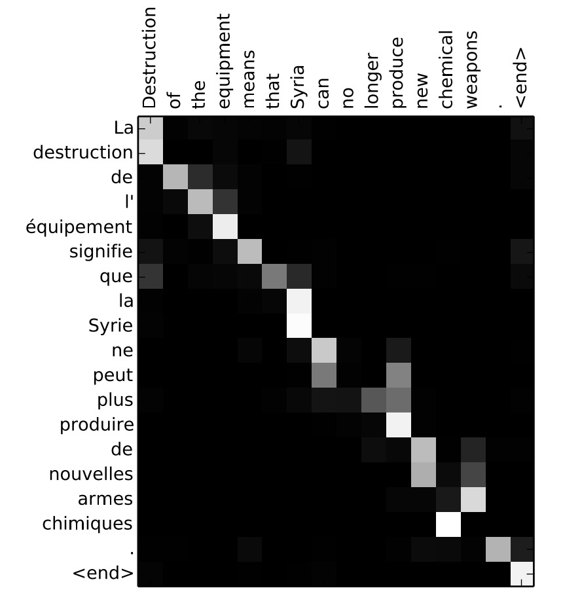
Attention examples
July 20th 1969
$1969−07−20$
${23}^{ }$April, $1564$
$1564−04−23$
Visualization of $α^{<t,t^{′}>}$:

Slide 31
Audio data
Speech recognition
deeplearning.ai

Slide 32

Speech recognition problem
$$x^{ }$$
$$y$$
audio clip
transcript
“the quick brown fox”

Slide 33
Attention model for speech recognition
“T”
“h”
$$s^{<2>}$$
$$⋯$$
$$s^{<1>}$$
$$+$$
$$a^{<0>}$$
$$⋯$$
$$x^{<1>}$$
$$⋯$$
$$x^{<999>}$$
$$x^{<2>}$$
$$x^{<1000>}$$

Slide 34
CTC cost for speech recognition
(Connectionist temporal classification)
“the quick brown fox”
$${\hat{y}}^{<1> }$$
$${\hat{y}}^{<2> }$$
$${\hat{y}}^{<1000> }$$
$$a^{<0>}$$
$$⋯$$
$$x^{<1>}$$
$$x^{<2>}$$
$$x^{<1000>}$$
Basic rule: collapse repeated characters not separated by “blank”
[Graves et al., 2006. Connectionist Temporal Classification: Labeling unsegmented sequence data with recurrent neural networks]

Slide 35
Audio data
Trigger word detection
deeplearning.ai

Slide 36



What is trigger word detection?
Amazon Echo
(Alexa)
Baidu DuerOS
(xiaodunihao)
Apple Siri
(Hey Siri)
Google Home
(Okay Google)

Slide 37
Trigger word detection algorithm
$$a^{<0>}$$
$$x^{<1>}$$
$$x^{<2>}$$
$$x^{<3>}$$

Slide 38
Conclusion
Summary and thank you
deeplearning.ai

Slide 39
Specialization outline
1. Neural Networks and Deep Learning
2. Improving Deep Neural Networks: Hyperparameter
tuning, Regularization and Optimization
3. Structuring Machine Learning Projects
4. Convolutional Neural Networks
5. Sequence Models

Slide 40
Deep learning is a super power
Please buy this from shutterstock and replace in final video.

Slide 41
Thank you.
-Andrew Ng

